Slide 1
Data Source (Bank, PocketBook, Gmail…)
Controlled environment (Raspberry Pi, iPhone, …)
PDS (encrypted personal data)
Personal data querying/processing “place”
PDS (encrypted personal data)
?
Controlled environment (Raspberry Pi, iPhone, …)
Personal data querying/processing “place”

Slide 2
Analytics consumers
Analytics consumers
Analytics consumers
Data Market
Service providers
Query Proc
Index
Filter config
Service providers
PDS
PDS
PDS
PDS
Data Providers
Data Providers
Data Providers
Data Providers

Slide 3
Browser extension
HTTP traffic “sniffing”
Opt-in/opt-out?
Filter configuration?
<>

Slide 4
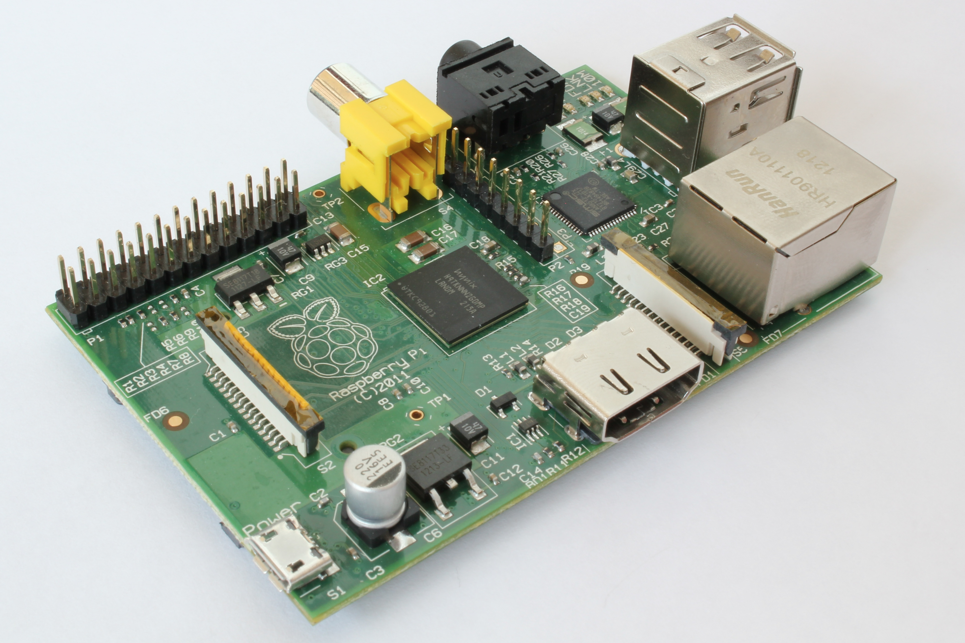

Slide 5
Build personal data store:
Existing solutions

